Slide 1

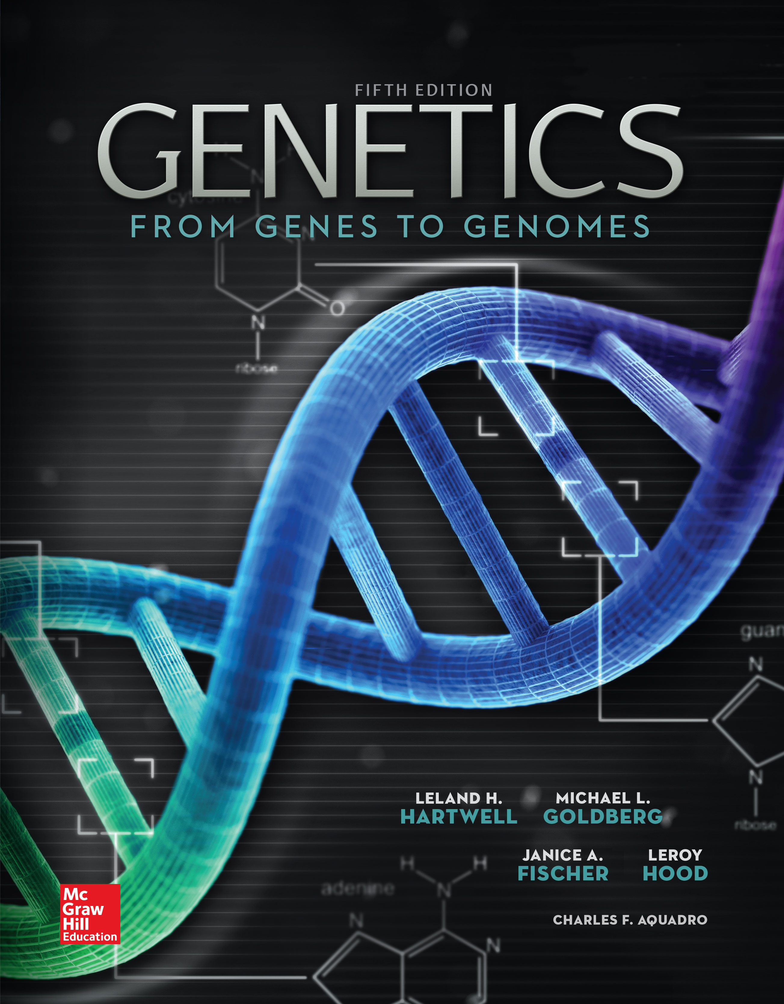
Genetics: From Genes to Genomes
Fifth Edition
Leland H. Hartwell, Michael L. Goldberg, Janice A. Fisher, Leroy Hood, and Charles F. Aquadro
Prepared by Kristin D. Patterson
University of Texas at Austin
Copyright © McGraw-Hill Education. Permission required for reproduction or display
1

Slide 2
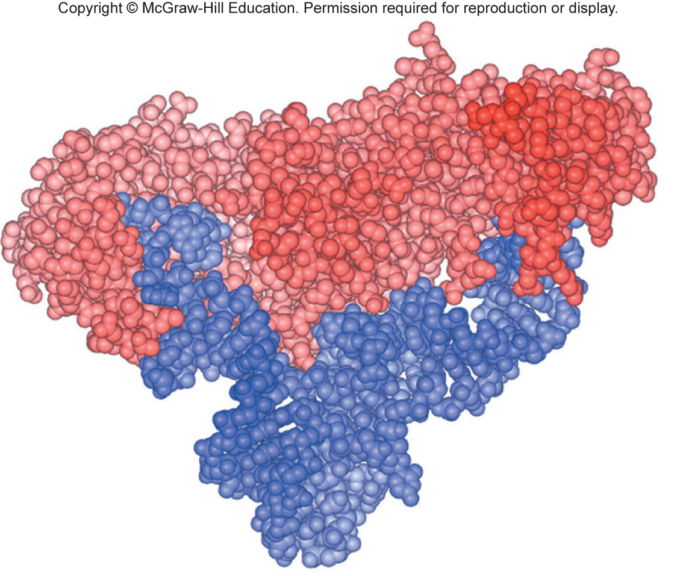
8
PART II
What Genes Are and What They Do
CHAPTER
CHAPTER
Gene Expression: The Flow of Information from DNA to RNA to Protein
CHAPTER OUTLINE
8.1 The Genetic Code
8.2 Transcription: From DNA to RNA
8.3 Translation: From mRNA to Protein
8.4 Differences in Gene Expression Between Prokaryotes and Eukaryotes
8.5 The Effects of Mutations on Gene Expression and Function

Slide 3
Four general themes for gene expression
Pairing of complementary bases is the key to the transfer of information from DNA to RNA and from RNA to protein.
Polarities of DNA, RNA, and polypeptides help guide the mechanisms of gene expression.
Gene expression requires input of energy and participation of specific proteins and macromolecular assemblies.
Mutations that change genetic information or obstruct the flow of its expression can have dramatic effects on phenotype.

Slide 4
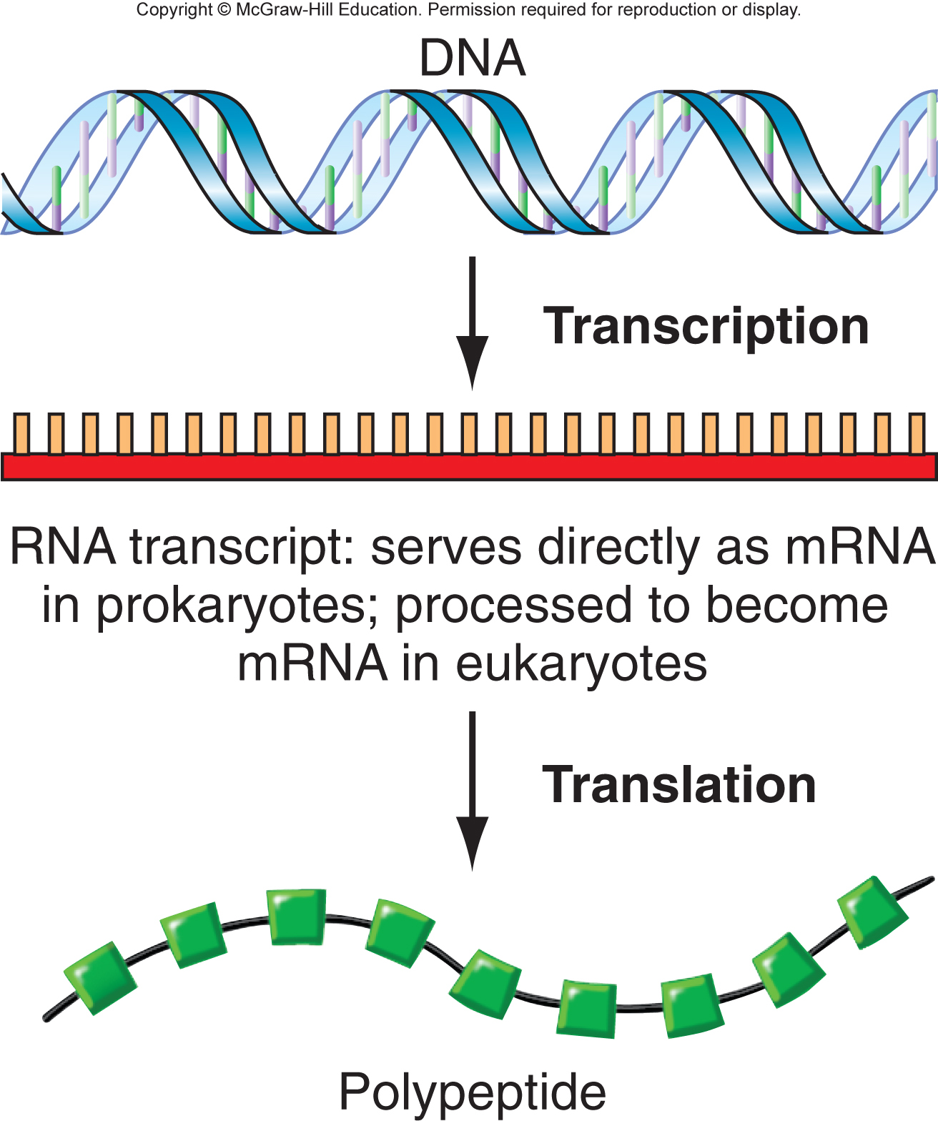
Gene expression: the flow of genetic information from DNA via RNA to protein
RNA polymerase transcribes DNA to produce an RNA transcript
Ribosomes translate the mRNA sequence to synthesize a polypeptide
Translation follows the "genetic code"

Slide 5
8.1 The genetic code
Learning objectives:
Explain the reasoning establishing that a sequence of three nucleotides is the basic unit of the code relating DNA to protein.
Summarize the evidence showing that the sequence of nucleotides in a gene is colinear with the sequence of amino acids in a protein.
Define reading frame and discuss its significance to the genetic code.
Describe experiments that determined which codons are associated with each amino acid and which are stop codons.
Explain how mutations were used to verify the genetic code.
Discuss evidence that the genetic code is almost universal and cite some exceptions.

Slide 6
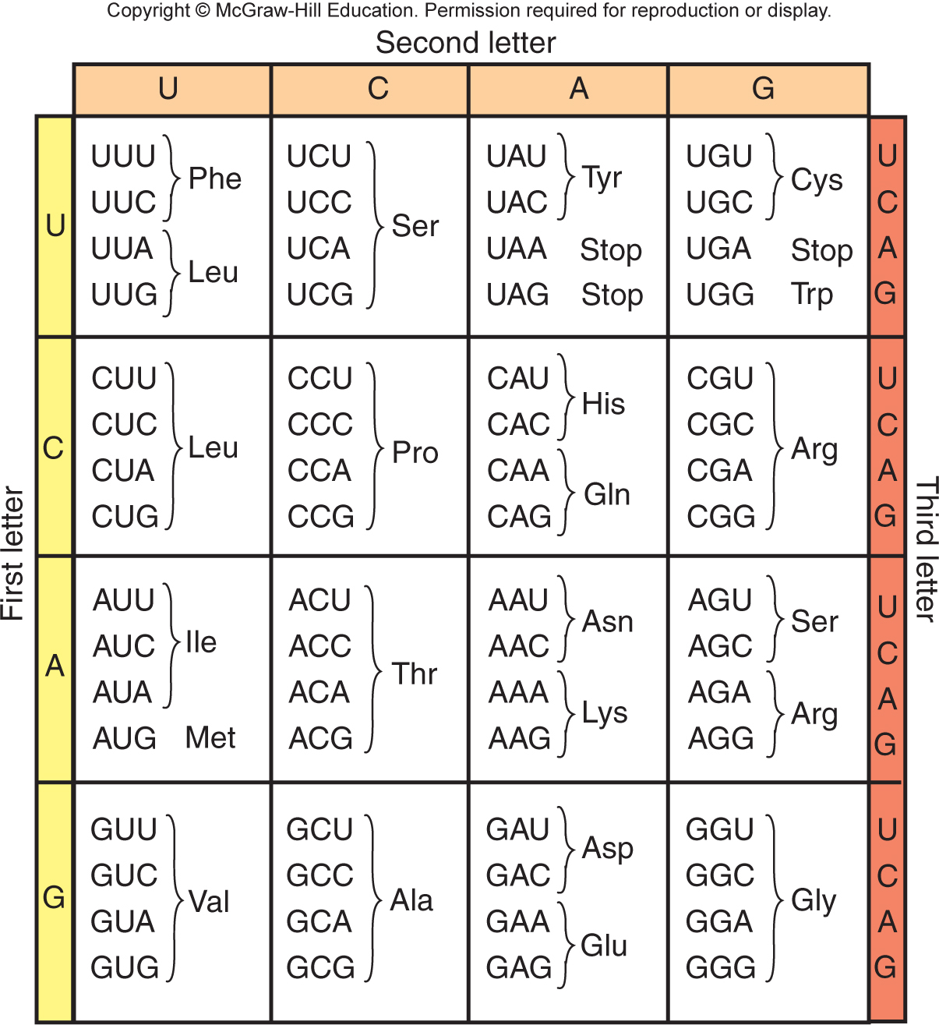
Triplet codons of nucleotides represent individual amino acids
How does DNA with 4 different nucleotide subunits encode 20 different amino acids?
1 nucleotide per amino acid is not enough information
2 nucleotide code = 4² = 16 combinations
3 nucleotide code = 4³ = 64 combinations
Experiments demonstrated that 3 nucleotides = codon= 1 amino acid

Slide 7
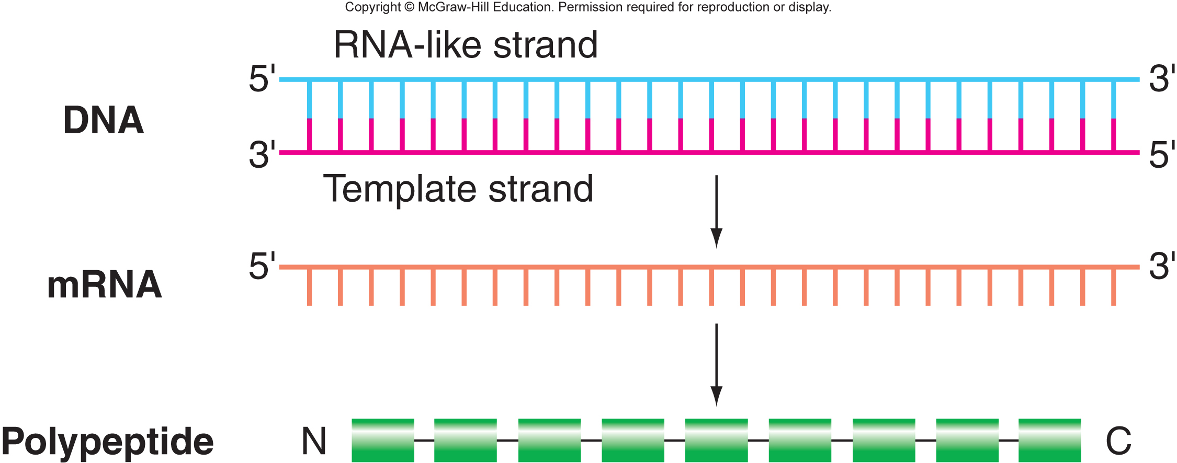
Correlation of polarities in DNA, mRNA, and polypeptide
Template strand of DNA is complementary to mRNA.
RNA-like strand of DNA has the same polarity and sequence as mRNA.
5’-to-3’ in the mRNA corresponds to N-to-C-terminus in the polypeptide

Slide 8
Summary of the genetic code
Genetic code has triplet codons
Codons are nonoverlapping
Three nonsense codons don’t encode an amino acid: UAA, UAG, and UGA
Genetic code is degenerate, yet unambiguous
Reading frame is established from a fixed starting point – codon for translation initiation is AUG
mRNAs and polypeptides have corresponding polarities
Mutations can be created in three ways; frameshift, missense, and nonsense

Slide 9
Genetic code is almost, but not quite, universal
Virtually all cells alive now use the same basic genetic code
In vitro translational systems from one organism can use mRNA from another organism to generate protein
Comparisons of DNA and protein sequence reveal perfect correspondence between codons and amino acids among all organisms
Genetic code must have evolved early in history of life
Exceptional genetic codes found in ciliates, mitochondria, and come prokaryotes

Slide 10
8.5 The effects of mutations on gene expression and function
Learning objectives:
Compare silent, missense, nonsense, and frameshift mutations in terms of how they alter a gene product.
Discuss mutations outside the coding sequence that could affect gene expression.
Explain why most loss-of-function alleles are recessive to wild-type, but some are incompletely dominant or dominant.
Contrast the actions of hypermorphic, neomorphic, and antimorphic gain-of-function alleles.
Give examples of mutations that can have global effects on gene expression.

Slide 11
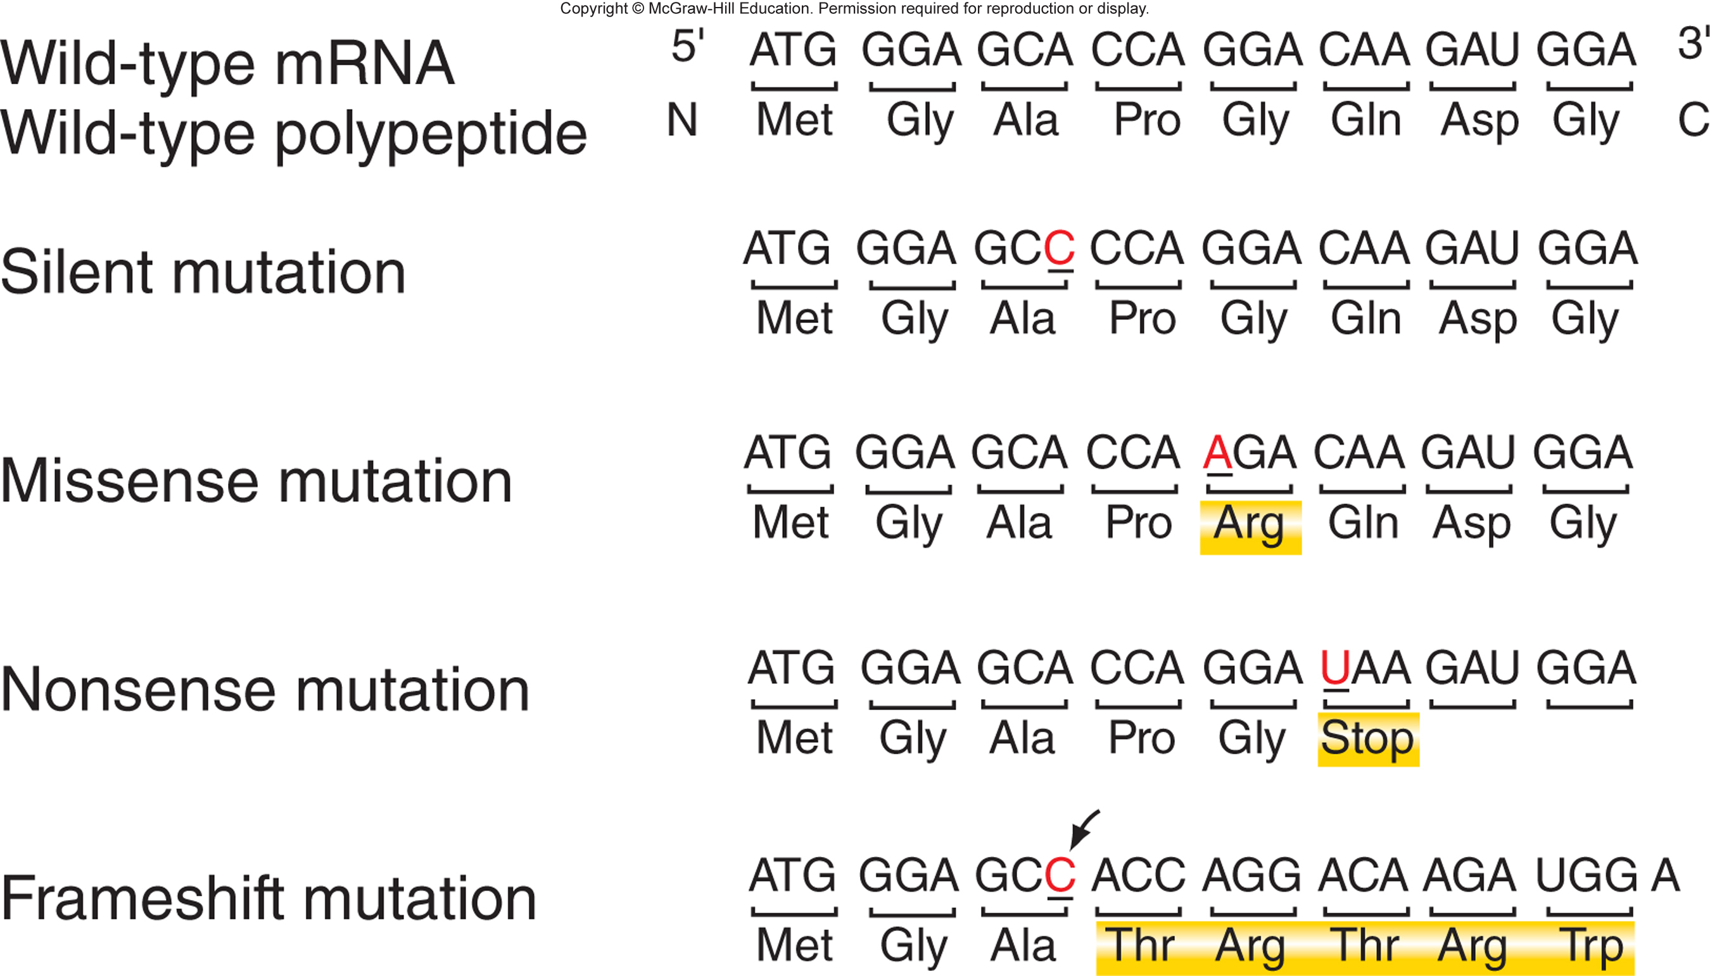
Types of mutations in the coding sequence of genes

Slide 12
Mutations in the coding sequence of a gene can alter the gene product
Missense mutations replace one amino acid with another
Conservative – chemical properties of mutant amino acid are similar to the original amino acid
e.g. aspartic acid [(-)charged] → glutamic acid [(-)charged]
Nonconservative – chemical properties of mutant amino acid are different from original amino acid
e.g. aspartic acid [(-)charged] → alanine (uncharged)

Slide 13
Mutations in the coding sequence of a gene can alter the gene product (cont)
Nonsense mutations change codon that encodes an amino acid to a stop codon (UGA, UAG, or UAA)
Frameshift mutations result from insertion or deletion of nucleotides with the coding region
No frameshift if multiples of three are inserted or deleted
Silent mutations do not alter the amino acid sequence
Degenerate genetic code – most amino acids have >1 codon

Slide 14
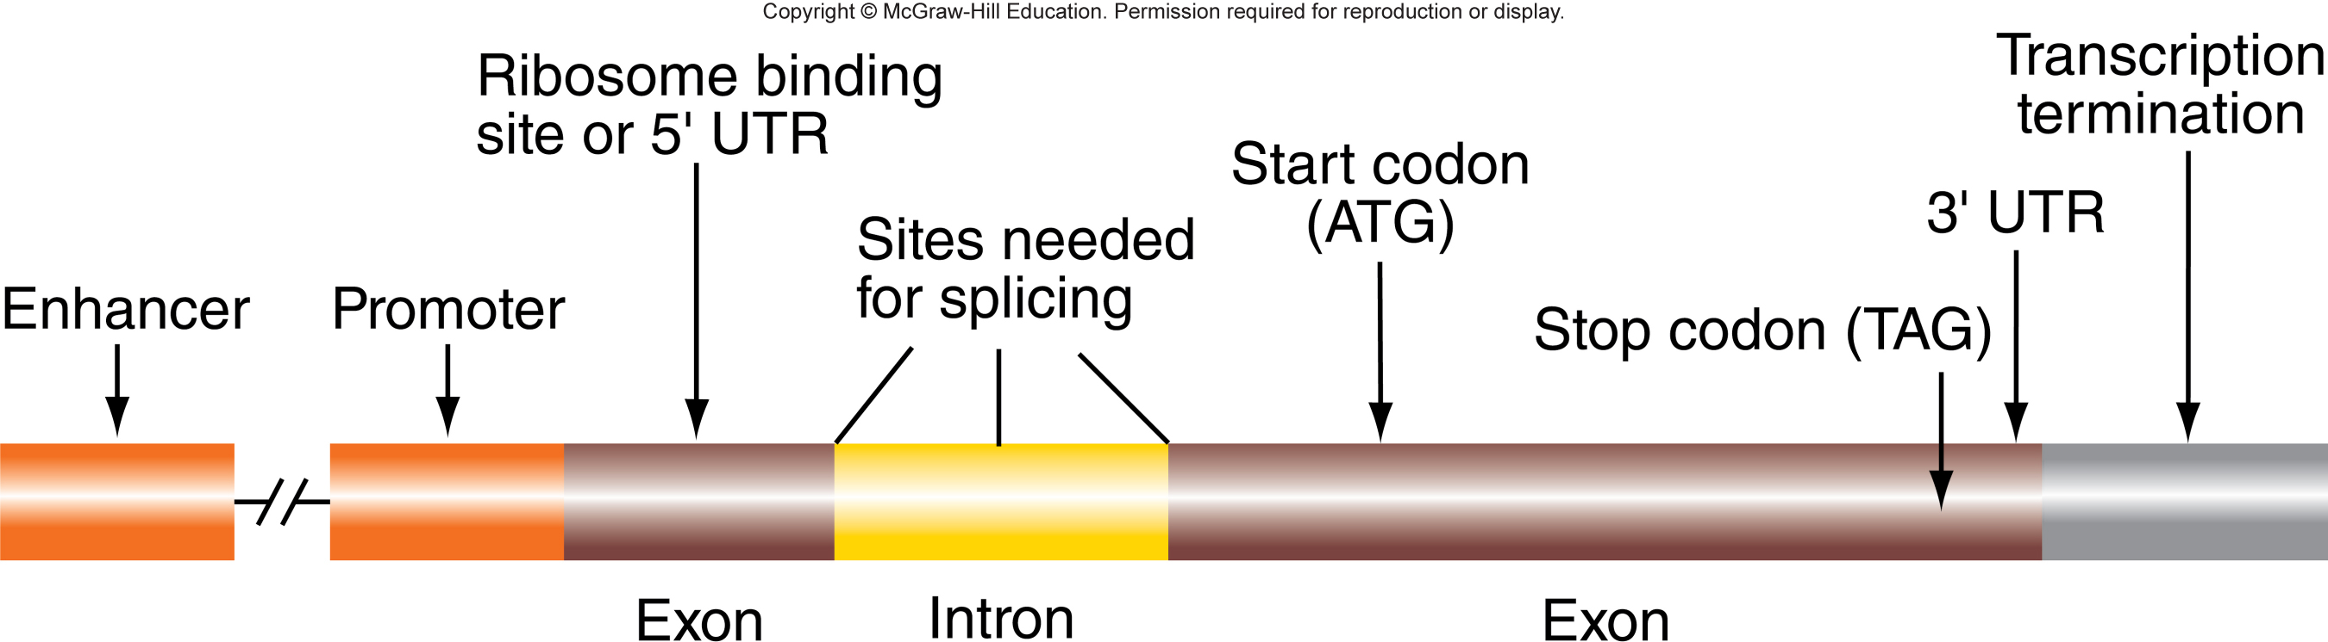
Mutations outside the coding sequence can disrupt gene expression

Slide 15
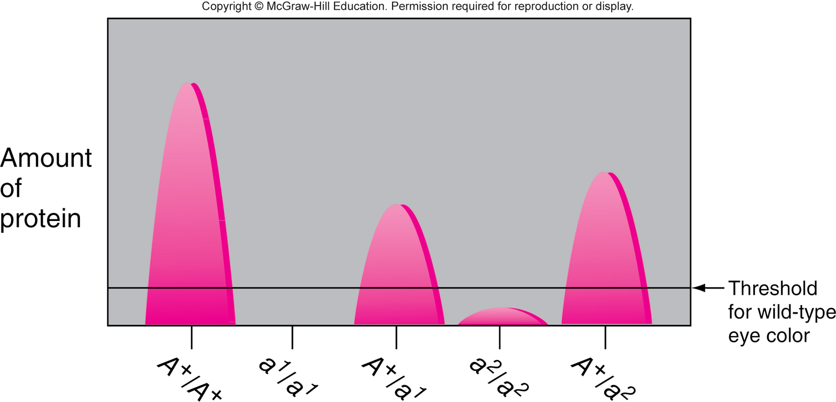
Loss-of-function mutant alleles are usually recessive to wild-type
Null (amorphic) mutations – completely block function of a gene product (e.g. deletion of an entire gene)
Hypomorphic mutations – gene product has weak, but detectable, activity

Slide 16
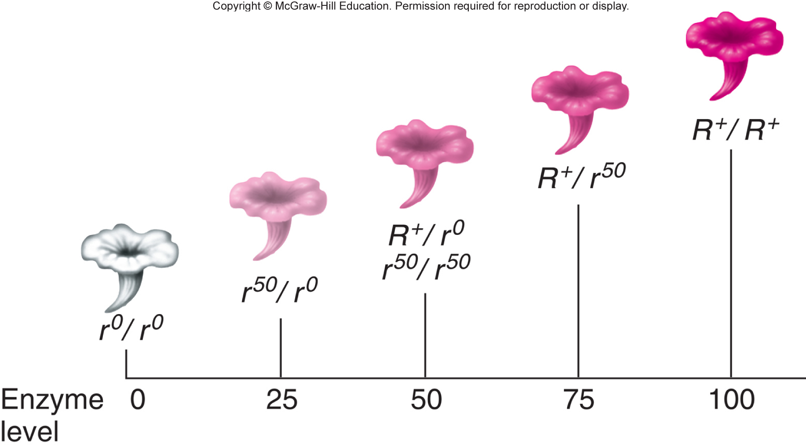
Some loss-of-function alleles can show incomplete dominance
Incomplete dominance – phenotype varies continuously with the amount of functional gene product

Slide 17
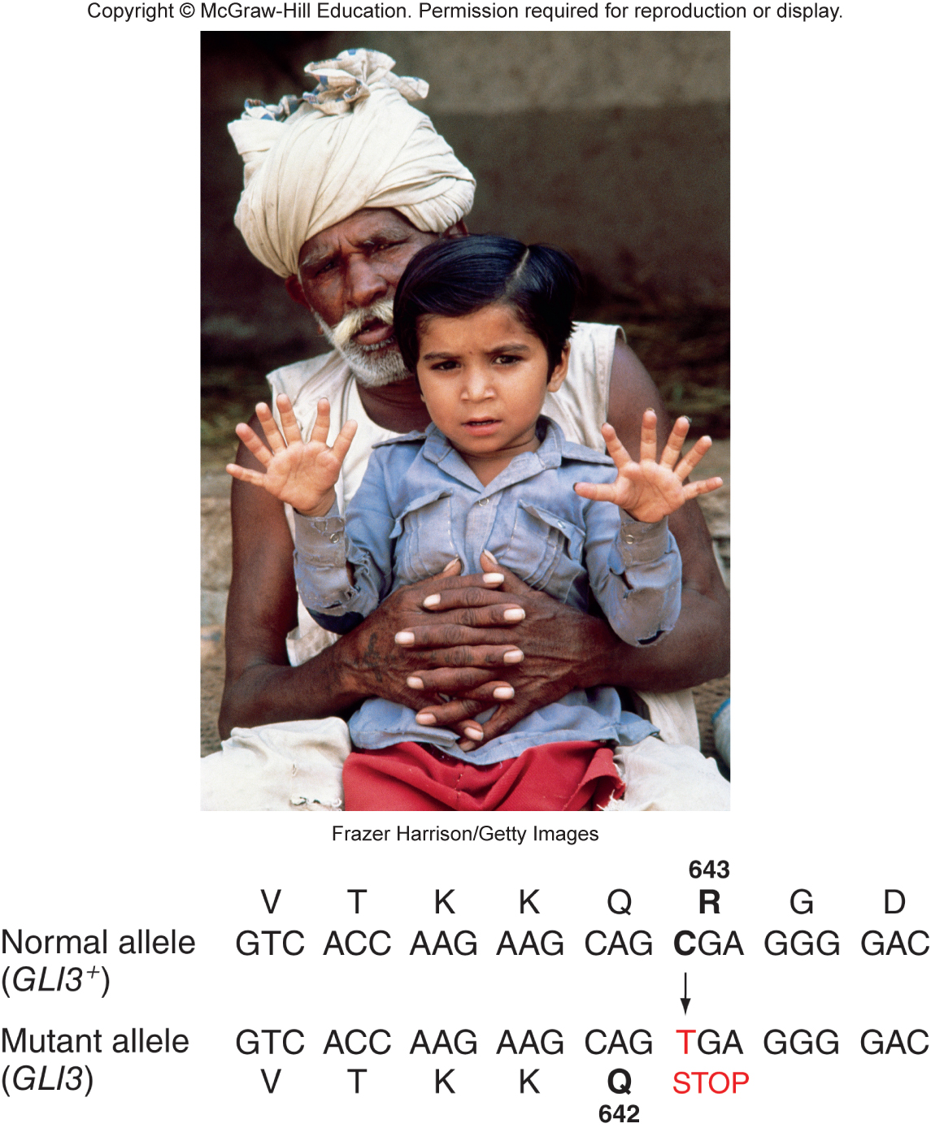
Some loss-of-function alleles are dominant to wild-type
Haploinsufficiency – phenotype is sensitive to gene dosage (i.e. 50% of gene product)
GLI3/GLI3⁺ humans have polydactyly.

Slide 18
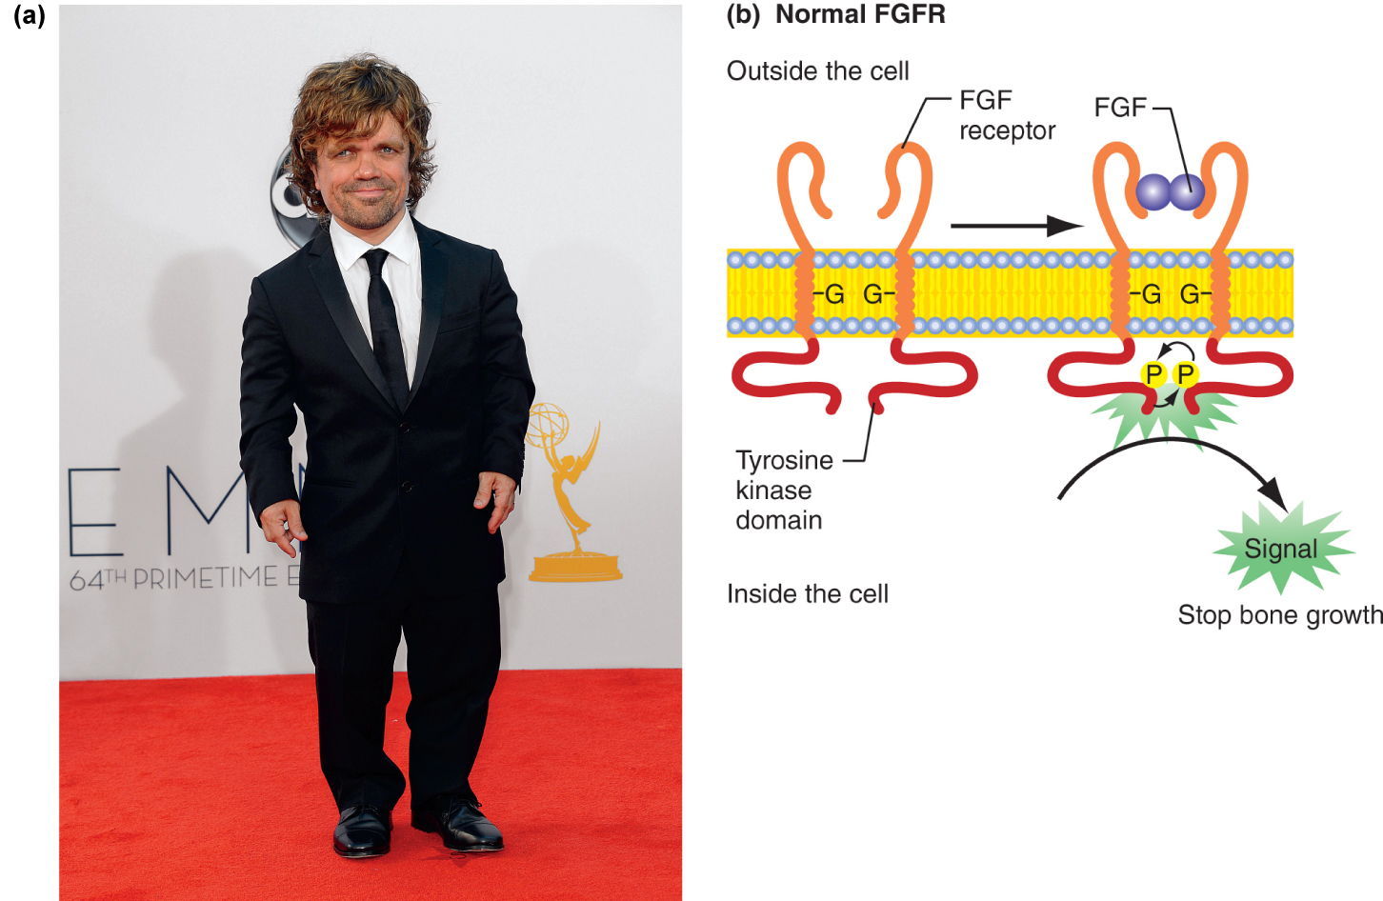
Gain-of-function mutations are usually dominant
Hypermorphic mutations – generate more gene product or the same amount of a more efficient gene product
The FGFR3 gene encodes a transmembrane receptor that is usually active only when bound to the FGF hormone.
Achondroplasia is caused by a dominant hypermorphic allele of FGFR3. The altered protein is always active.

Slide 19
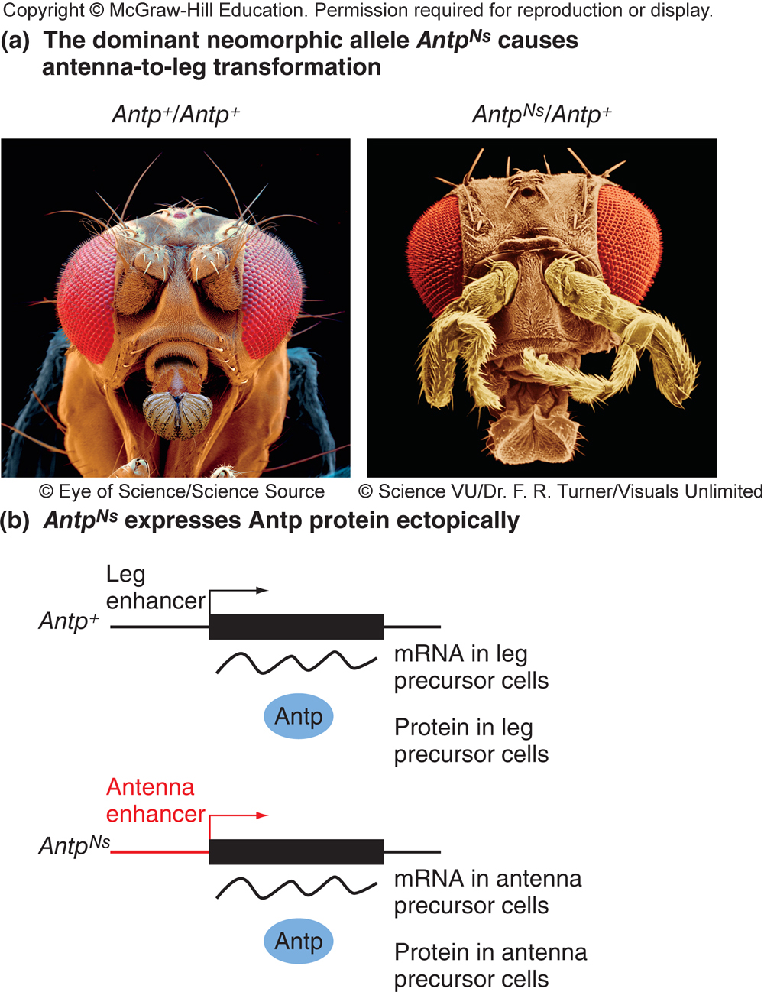
Gain-of-function mutations are usually dominant
Neomorphic mutations – generate gene product with new function or that is expressed at inappropriate time or place
Mutation in Antennapedia gene of Drosophila causes ectopic expression of a leg-determining gene in structures that normally produce antennae

Slide 20
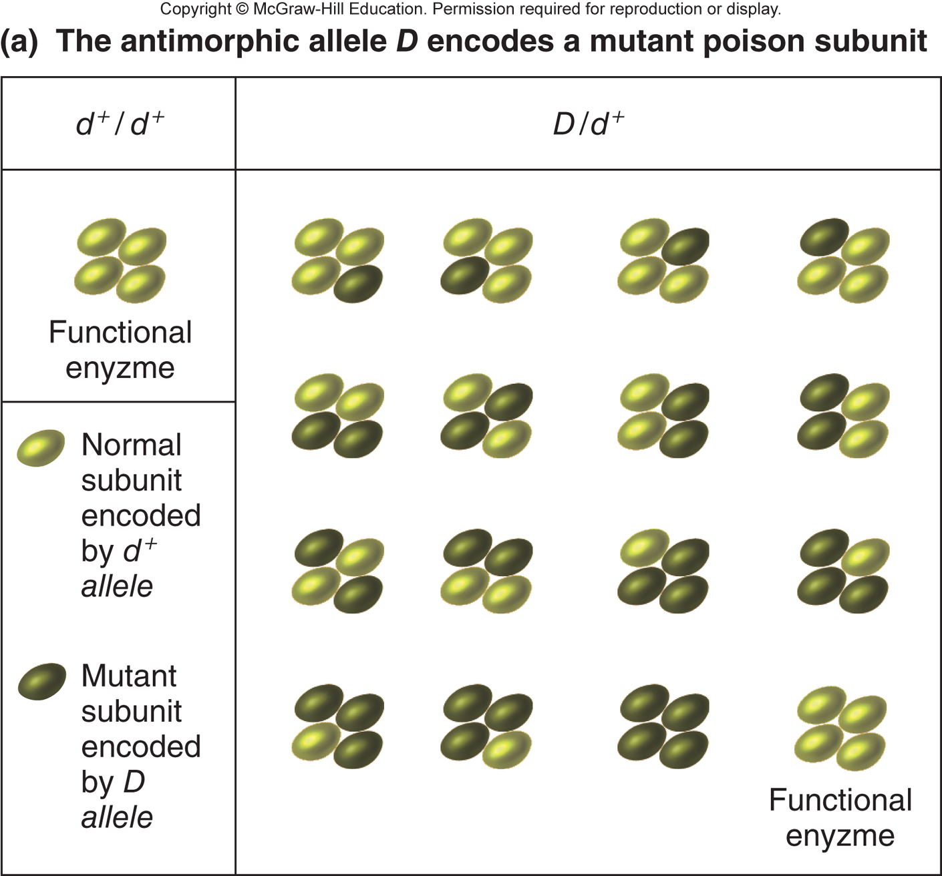
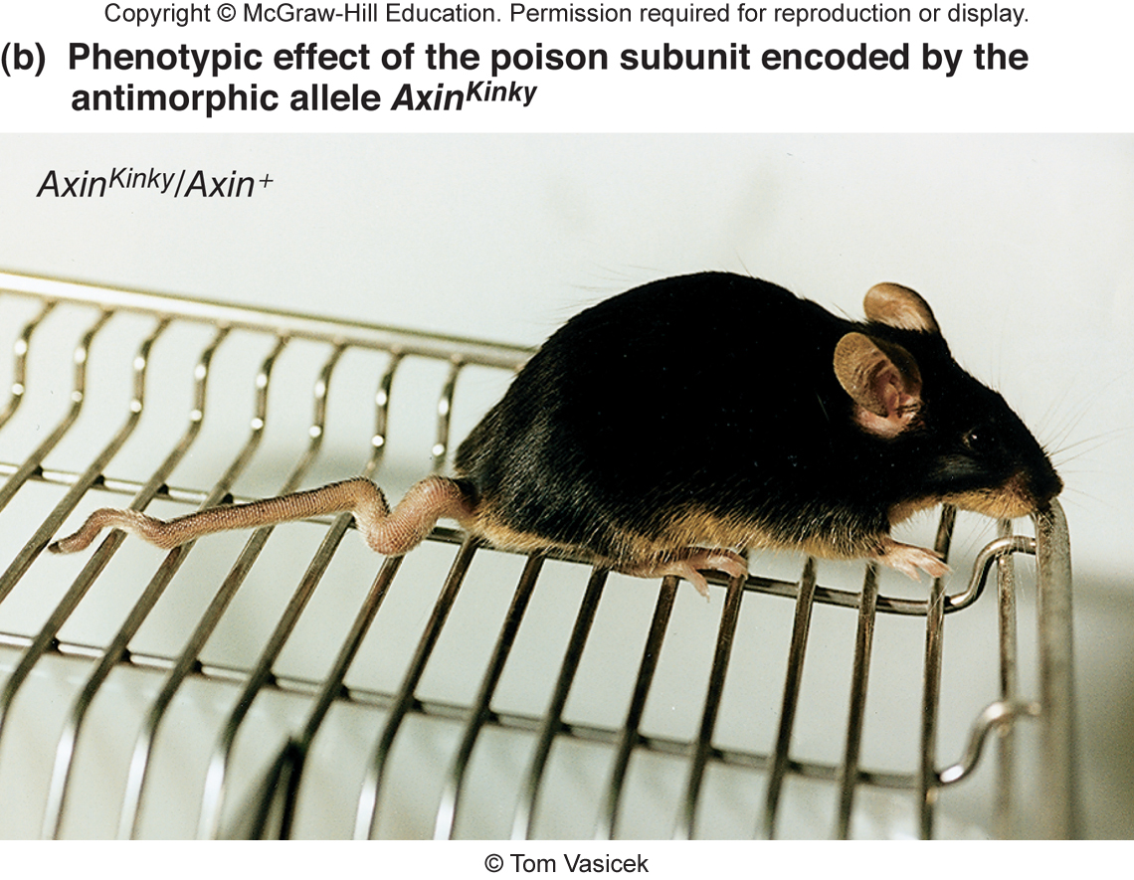
Antimorphic (dominant negative) alleles prevent the normal protein from functioning
Usually occurs in genes that encode multimeric proteins
Mutant subunits block the activity of normal subunits

